Slide 1
Virtual Machines

Slide 2

Virtualization
Virtualization deals with “extending or replacing an existing interface so as to mimic the behavior of another system”
Virtual system examples: virtual private network, virtual memory, virtual machine

Slide 3
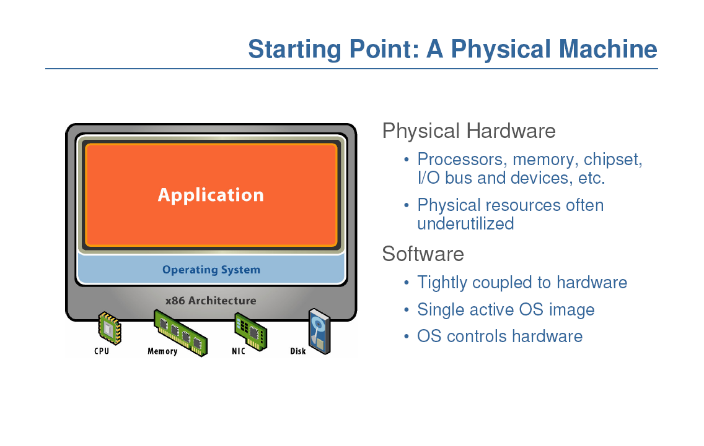

Slide 4
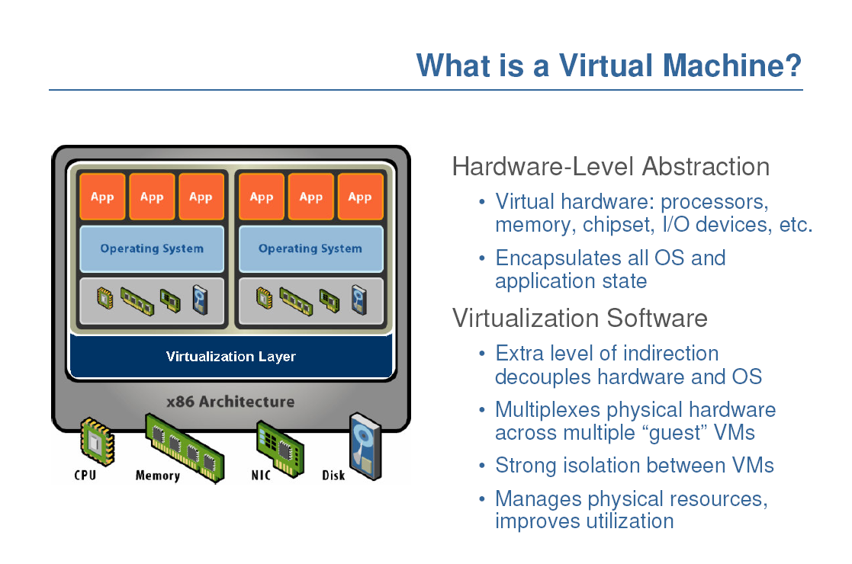

Slide 5
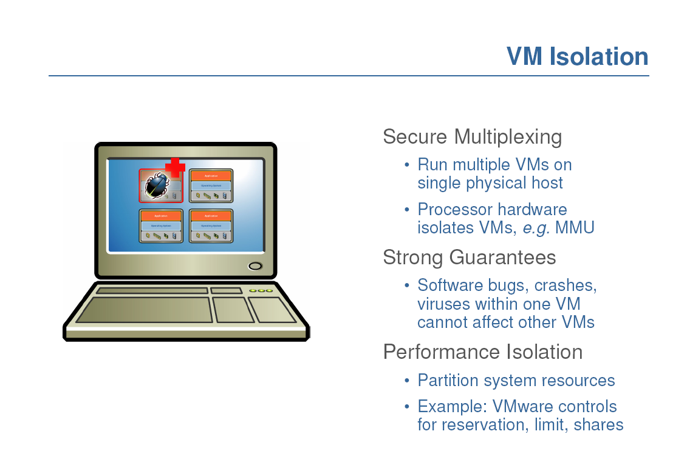

Slide 6
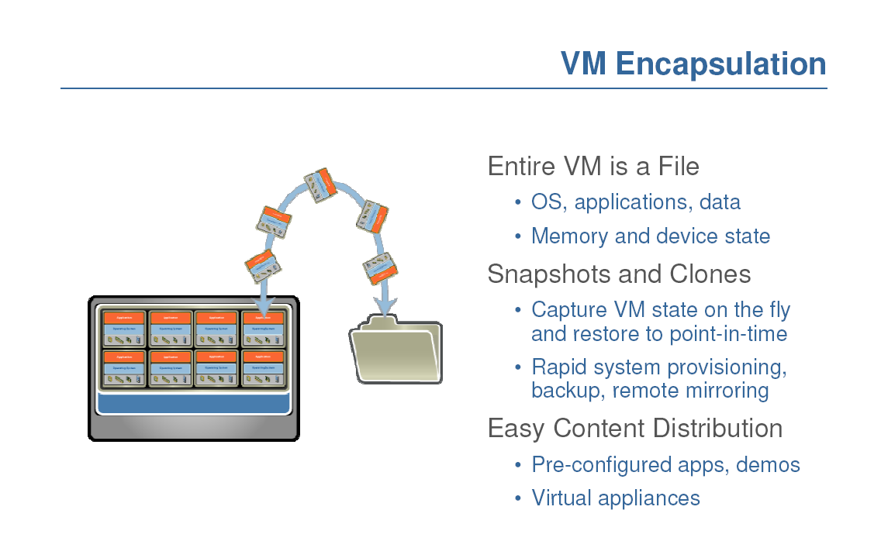

Slide 7
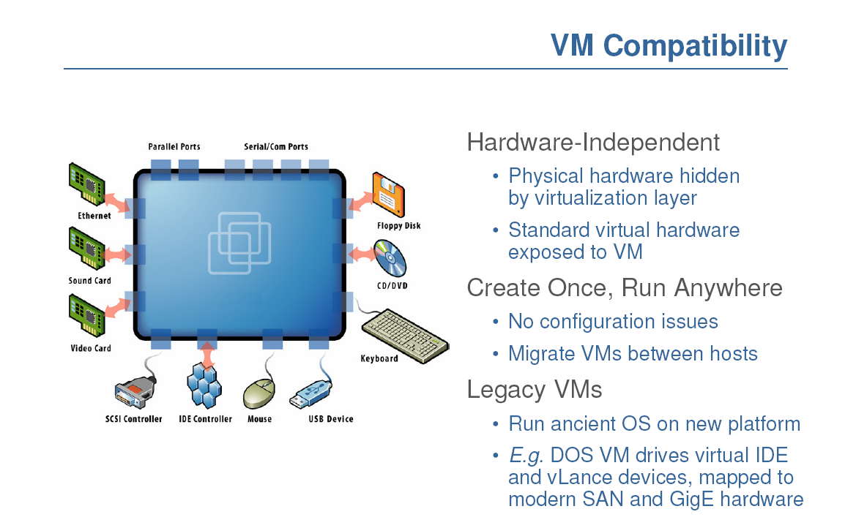
Notes:
Hardware and low-level systems software change quickly
High-level software (middleware, applications) changes more slowly

Slide 8
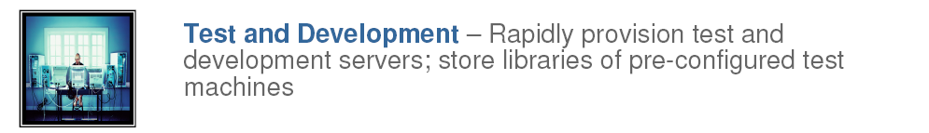
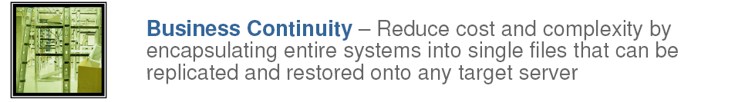
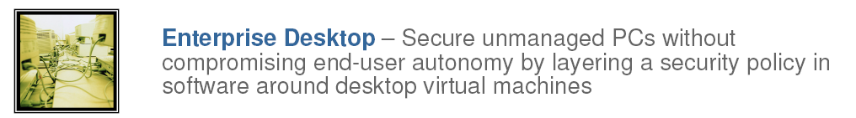

Slide 9
Run legacy software on non-legacy hardware
Run multiple operating systems on the same hardware
Create a manageable upgrade path
Manage outages (expected and unexpected) dynamically

Slide 10
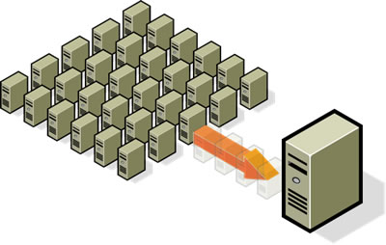
Reduce costs by consolidating services onto the fewest number of physical machines
http://www.vmware.com/img/serverconsolidation.jpg

Slide 11

Non-virtualized Data Centers
Too many servers for too little work
High costs and infrastructure needs
  Maintenance
  Networking
  Floor space
  Cooling
  Power
  Disaster Recovery

Slide 12
Dynamic Data Center
Virtualization helps us break the “one service per server” model
Consolidate many services into a fewer number of machines when workload is low, reducing costs
Conversely, as demand for a particular service increases, we can shift more virtual machines to run that service
We can build a data center with fewer total resources, since resources are used as needed instead of being dedicated to single services
Notes:
Or sitting and waiting until the next spike in demand

Slide 13
VM workload multiplexing
Separate VM sizing
VM multiplexing
s₃
s₂
s₁
We expect s₃ < s₁ + s_{2.} Benefit of multiplexing !
  Multiplex VMs’ workload on same physical server
    Aggregate multiple workload. Estimate total capacity need based on aggregated workload
    Performance level of each VM be preserved

Slide 14
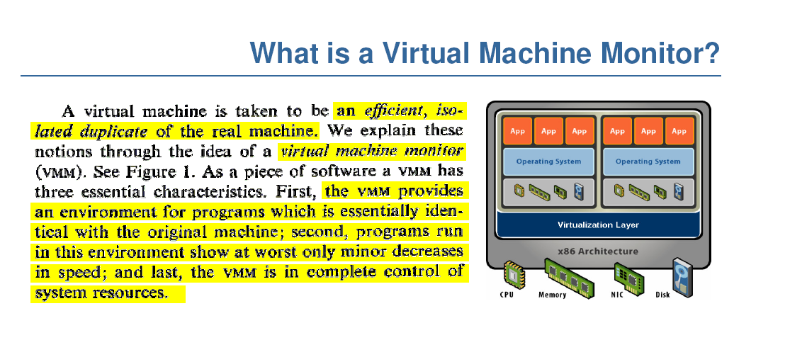
So, it is just like Java VM, right?

Slide 15
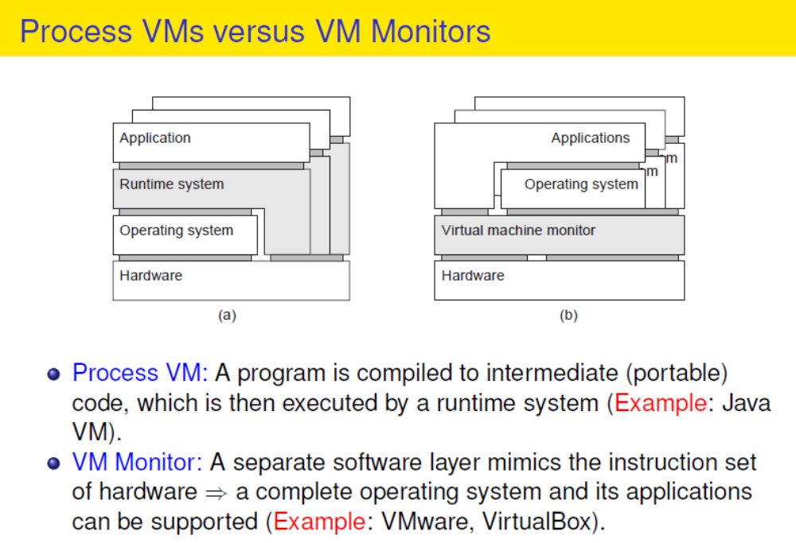

Slide 16
Thee Virtualization Approaches
  Full Virtualization
  Paravirtualization
  Hardware-assisted Virtualization

Slide 17
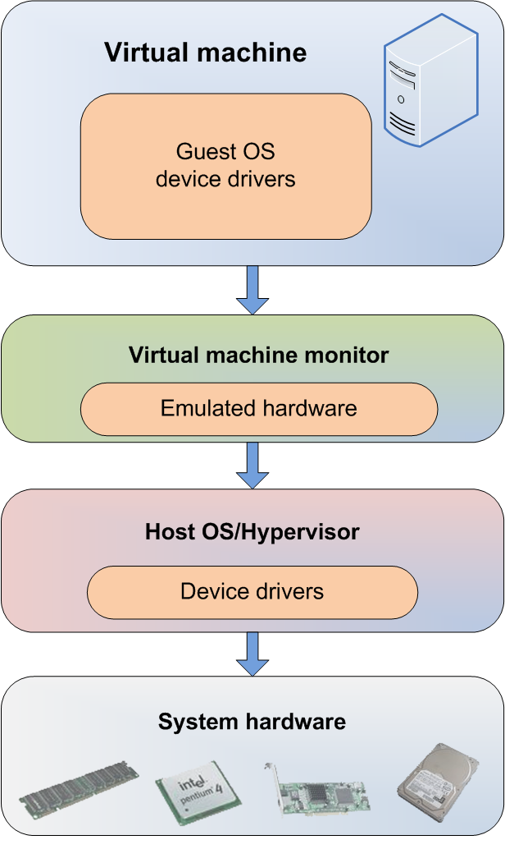
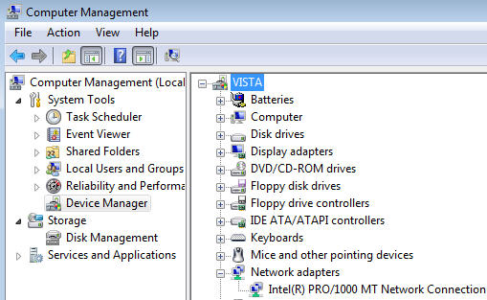
Full Virtualization
  Everything is virtualized
  Full hardware emulation
  Emulation = latency

Slide 18
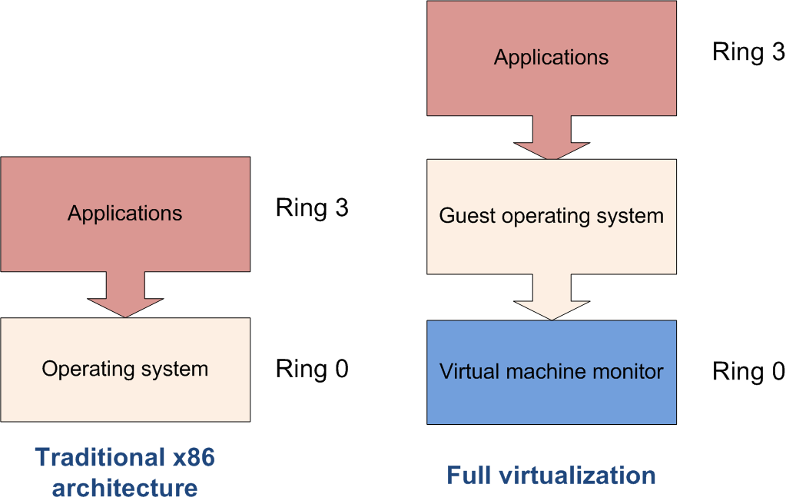
Privileged Instructions
  Privileged instructions: OS kernel and device driver access to system hardware
  Trapped and emulated by VMM
Notes:
http://en.wikipedia.org/wiki/Ring_%28computer_security%29
Privilege rings for the x86 available in protected mode
Microsoft's Ring-1 design structure as part of their NGSCB initiative and hypervisors embedded in firmware such as Intel VT-x (formerly Vanderpool).

Slide 19
Pros and Cons – Full Virtualization
Pros
  Disaster recovery, failover
  Virtual appliance deployment
  Legacy code on non-legacy hardware
Cons – LATENCY of core four resources
  RAM performance reduced 25% to 75%
  Disk I/O degraded from 5% to 20%
  Network performance decreased up to 10%
  CPU privileged instruction dings nearing 1% to 7%

Slide 20
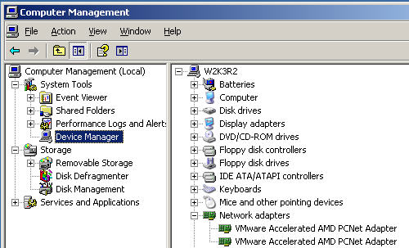
Paravirtualization
  OS or system devices are virtualization aware
Requirements:
  OS level – recompiled kernel
  Device level – paravirtualized or “enlightened” device drivers

Slide 21
Paravirtualization
Pro: fast
Con: requires a specially modified guest OS, thus precludes the ability to run off-the-shelf and legacy OS in paravirtual environments

Slide 22
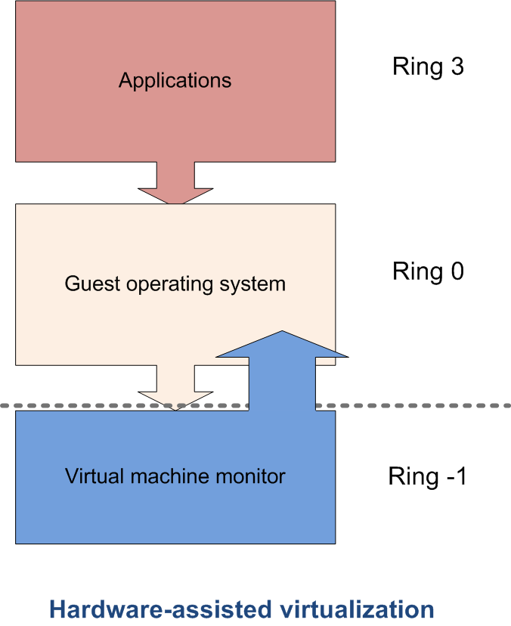
Hardware-assisted Virtualization
  Server hardware is virtualization aware
  Hypervisor and VMM load at
  privilege Ring -1 (firmware)
  Removes CPU emulation bottleneck
  Memory virtualization coming in quad
  core AMD and Intel CPUs

Slide 23







Evolution of Software solutions*
1st Generation: Full virtualization (Binary rewriting)
  Software Based
  VMware and Microsoft
2nd Generation: Paravirtualization
  Cooperative virtualization
  Modified guest
  VMware, Xen
3rd Generation: Silicon-based (Hardware-assisted) virtualization
  Unmodified guest
  VMware and Xen on virtualization-aware hardware platforms
Virtual
Machine
Virtual
Machine
…
Dynamic Translation
VM
…
VM
Virtual
Machine
Virtual
Machine
Hypervisor
…
Operating System
Hypervisor
Hardware
Hardware
Hardware
Time
Virtualization Logic
*This slide is from Intel® Corporation

